Slide 1

Steering Data Projects to Success
Lessons from the Field
Pedro Martins | pedro.martins@dxc.com
Lisbon, July 4th 2018

Slide 2

About Myself
Data Warehousing
Business Intelligence
Reporting
Data Visualization
Big Data
Cloud (Azure, AWS)
Roles
Insurance
Pharma
Industrials
Skills
Data Modeler
Data Analyst
Data Engineer
Viz Engineer
Project Manager
Solution Architect
Sales Engineer
Industries
2006 – 2018 | Consulting | Enterprise

Slide 3


About Myself II

Slide 4
WHY ARE DATA PROJECTS SO SPECIAL?

Slide 5
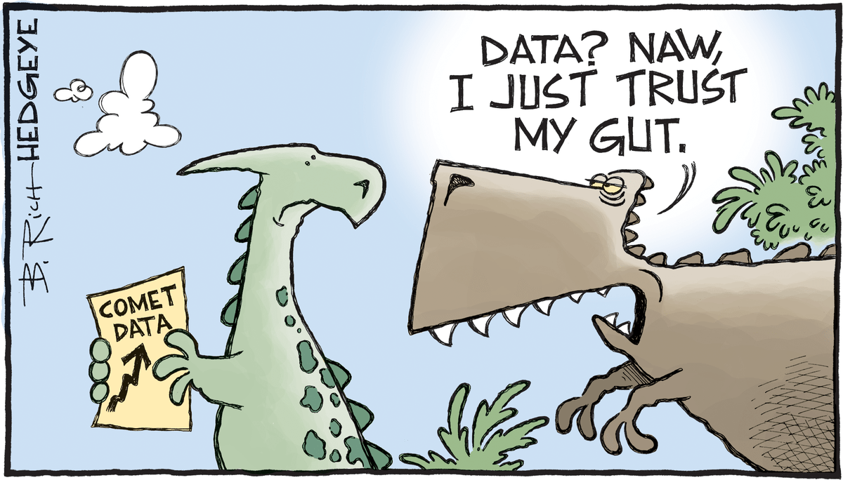
Why are Data Projects so Special?

Slide 6
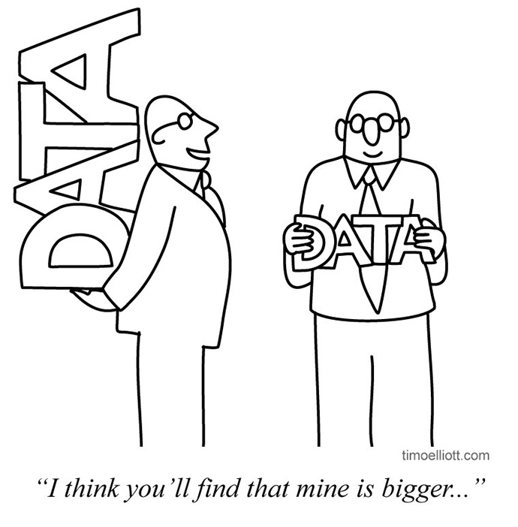
Why are Data Projects so Special?
Data Projects are about Change (Sometimes disruption)
Transform Culture
Require New People and New Roles
Merge Technical and Business Expertise
Create Conflict

Slide 7
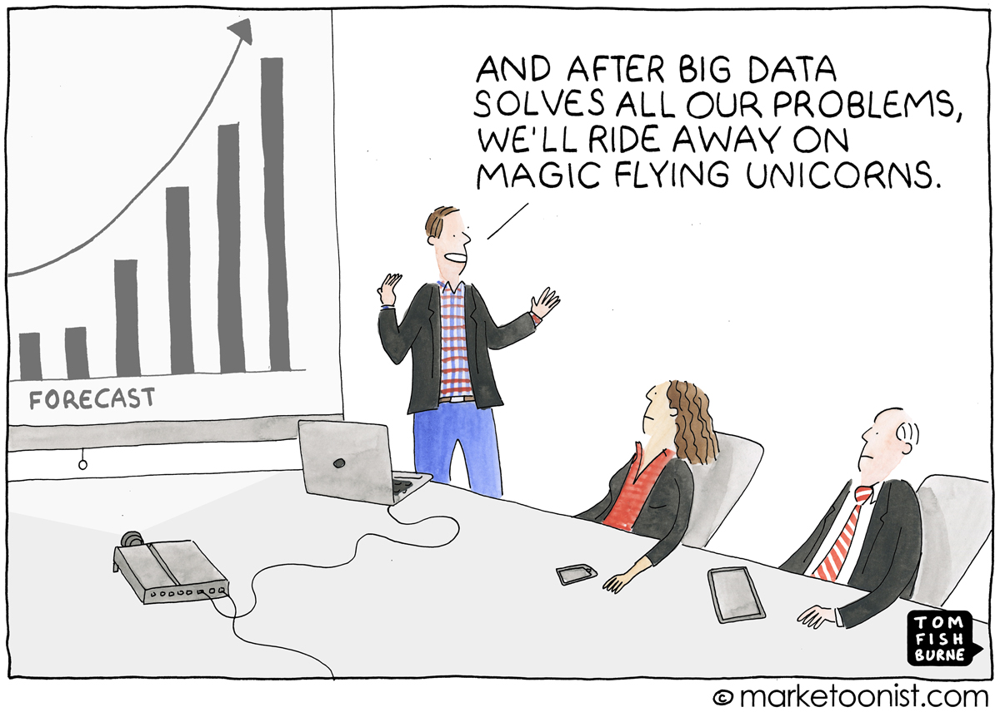
The Promise

Slide 8
Complexity? Where?
Technical Complexity
Business Complexity
Management of Expectations

Slide 9
Technical Complexity
Programming
Python
R
Java
Scala
C++
Frameworks
Tensorflow
Spark
Map/Reduce
Node JS
CI/CD
Jenkins
Git
Jira
Confluence
Platforms
Cloudera
Hortonworks
ElasticSearch
OS
Windows
Linux
Unix
Tools
Trifacta
Talend
H2O
Weka
Databases
Oracle
MySQL
Postgres
Mongo
Teradata
MS SQLServer
Cloud
Google Cloud Platform
Azure
AWS
Digital Ocean
DevOps
Ansible
Puppet
Vagrant
Visualisation
Spotfire
Tableau
QlikView
Angular
D3
Shiny
PowerBI

Slide 10


Technical Complexity
DXC
Data Ninja
Consultant
Architect
Data Scientist
Data Engineer
DevOps Engineer

Slide 11
Business Complexity
Time
Cost
Quality
Business
Analysis
People
Management
Process
Development
Priorities
Management
Communication
Politics

Slide 12
Management of Expectations
Business
Knowledge
Technical
Knowledge
Notes:
This brings us to a second challenge: Work in the field of analytics is highly sensitive to what is sometimes called the “TCQ triangle.” When businesses undertake new projects, they typically try to balance three factors — time, cost, and quality. In general, it’s impossible to maximize all three of these attributes at the same time. If you want to do a project quickly and cheaply, quality is likely to suffer; if you want to do the project quickly and to a high standard, it will probably cost more; if you want to do the project cheaply but at high quality, it will take longer.
Analytics teams often find themselves in the middle of implicit organizational debates about which of these factors matter most. Because businesses are accustomed to measuring time and cost (entire departments may exist to do this), these are the two dimensions over which businesses typically look to economize.
https://sloanreview.mit.edu/article/why-managing-data-scientists-is-different/

Slide 13
Q | What are the greatest risks that can cause Data projects to fail?

Slide 14
HOW DOES IT LOOK LIKE IN THE REAL WORLD?

Slide 15

Becoming Data-Driven
ACME Inc.
Traditional business (Auto parts)
CEO issues new strategic imperative to become a data-driven
company.
“Act on data faster than our competition”
“Create competitive advantages”

Slide 16
Current State
Current data assets
Data marts for Finance and Sales
Static reports for month-end consumption
Developed by external company
IT given the goal:
New Data Science Team!

Slide 17
Skeletons in the Closet
Data Quality
Lots of missing data
Existing data with quality issues
Business logic coded in reports
6 months time cleaning / preparing data, creating reports...

Slide 18
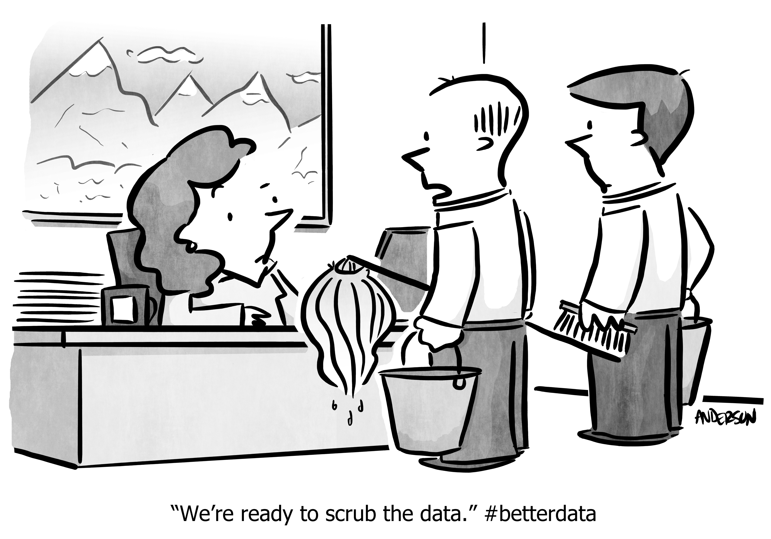
Skeletons in the Closet

Slide 19
The First Step
Options and Priorities
Sales – Campaign Optimization
Finance – Spend Analytics
HR – Attrition Prediction
The Decision
Business Case Analysis
Domain Knowledge
Go-Ahead for Sales

Slide 20
The Process
Data Sources
Internal data sets insufficient
Need to purchase new data sets to feed models
Funding not available for all identified sources
Connecting to the Business
DS team not too knowledgeable about Auto Parts
Focus mostly on technical tasks (Data Prep, Feature Engineering, Model Optimization)
Not too keen on leveraging existing business knowledge (Bias)

Slide 21
The Outcomes
The Model
Product / Account mix for targeted campaigns
Model reasonably explainable
Goes against latest findings by Sales
Political issues
Credibility and self-defense
Model is labeled as unreliable and discredited by Sales
Data Science team undermined

Slide 22
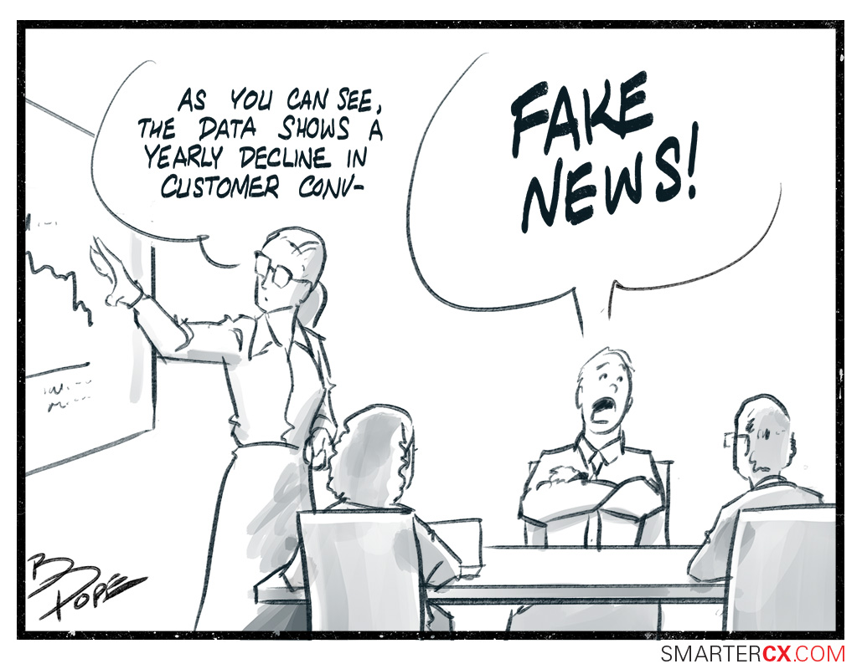
The Outcomes

Slide 23
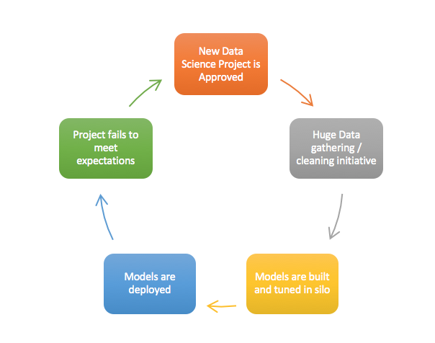
In a Nutshell

Slide 24
Q | How can we minimize risk when delivering Data projects?

Slide 25
HOW CAN WE SUCCED?

Slide 26
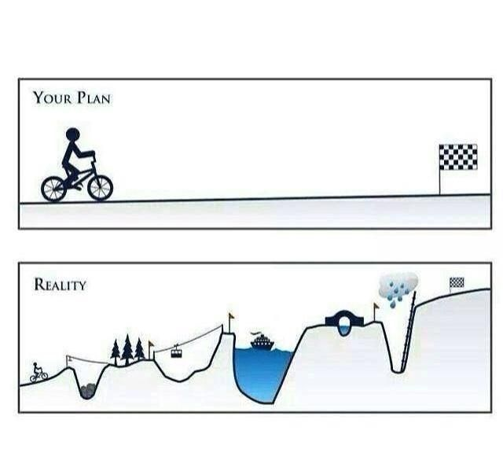
The Road to Success

Slide 27
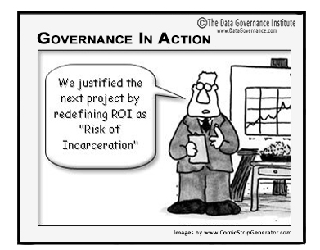
1. Understand the Context
What are the business goals being
supported by the project?
Who are the key people supporting
the project?
Is there adequate funding?

Slide 28

2. Build the Right Skill Set
Technical
Business
Communication
Analysis
Courage

Slide 29
3. Communication is Essential
Technical – Are we on track with the key deliverables?
Business – Are we aligned with the project goals?
Leadership – Are we aligned with the company direction?
Notes:
Make the Data team part of the company!

Slide 30
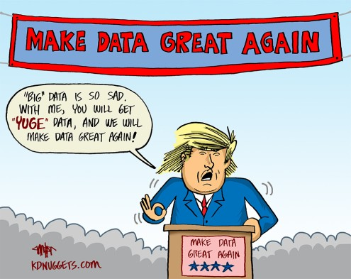
4. Sell, Sell, Sell

Slide 31
“Data is the Sword of the 21st Century, those who wield it well, the Samurai”
William Rosenberg

Slide 32
Thank you.

